Slide 1



Data Science Project
Telecom customer churn
Group 5
Ms. Ranvir Pooja Gopichand
Ms. Seema Dhama
Mr. Surya Chaitanya
Mr. Ajith Singh
Mr. Vaibhav Mane
Mr. Rama V.S. Murty

Slide 2
Business objective
The objective of the project is to model churn probability, conditioned on the given customer features;
Highlight main variables/factors influencing customer churn.
This is a classification project;
The variable to be predicted is binary (churn or not churn);

Slide 3
Background
“Customer churn” is when a customer chooses to stop using products or services of a company.
Customer churn is a big problem for telecommunications companies with an annual churn rates are usually higher than 10%.
To develop strategies to retain customers, it is vital to predict the possible churn customers;
Usually, there are early indicators or metrics that can be uncovered through churn data analysis.
Early signs of potential churn may be possible to detect through:
insight of customers data
customer interactions (store visits, product purchase history, service calls, web transactions, and social media).
Data Set Details: Churn.csv
each row corresponds to data of a client
the target variable “churn” indicates whether a customer is churned out or not;

Slide 4
Features
State : Categorical, for the 51 states and the District of Columbia.
Area.code : Categorical, 408, 415, 510
account.length : how long the account has been active.
voice.plan : yes or no, voicemail plan.
voice.messages : number of voicemail messages.
intl.plan : yes or no, international plan.
intl.mins : minutes customer used service to make international calls.
intl.calls : total number of international calls.
intl.charge : total international charge.
day.mins : minutes customer used service during the day.
day.calls : total number of calls during the day.
day.charge : total charge during the day.
eve.mins : minutes customer used service during the evening.
eve.calls : total number of calls during the evening.
eve.charge : total charge during the evening.
night.mins : minutes customer used service during the night.
night.calls : total number of calls during the night.
night.charge : total charge during the night.
customer.calls : number of calls to customer service.
Churn : Categorical, yes or no.

Slide 5
Exploratory data analysis (EDA)
Dataset details:
5000 non-null records (or rows);
21 features;
dtypes: float (6), int (8), object (7);
‘day.charge, eve.min are float but info showed as object, may be due to the presence of few ‘Nan’ values;
‘Unnamed: 0’ column can be dropped;
No duplicates;
No null values;

Slide 6
EDA…
Describe dataset: Statistics for numerical variables
Before converting object columns to numeric
After converting object columns to numeric
No change in statistics of other variables even after removing rows containing ‘Nan’;
No need to remove the 31 customers data;
‘Nan’ values could be imputed with mean values of that feature.

Slide 7
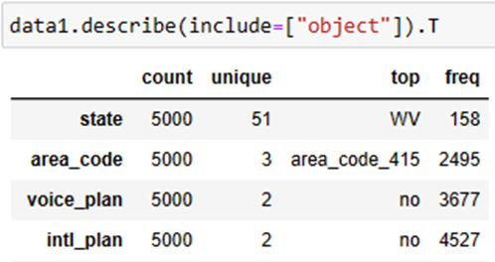
EDA…
Describe dataset: Statistics for categorical variables
The describe function for the categorical variables resulted:
the number of unique values,
highest category within each feature and
their frequency.

Slide 8
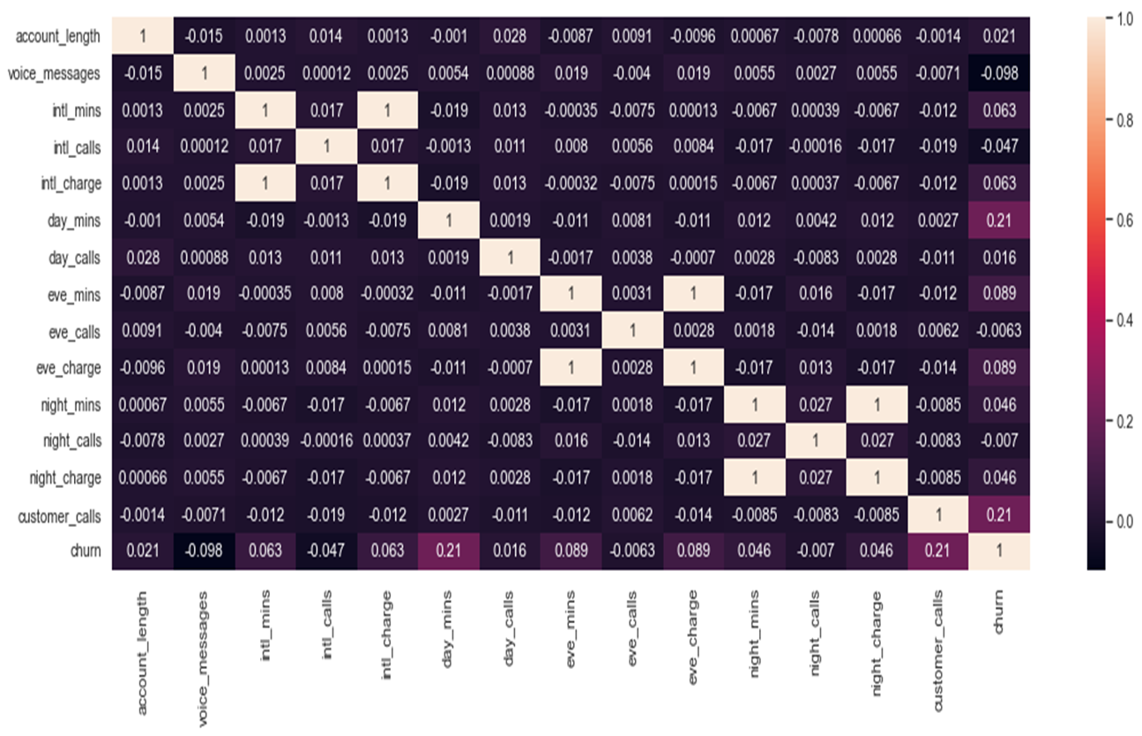
EDA…
Heatmap of correlation
Strong correlation observed within features set – calls, min., charge;
One of the 3 features (calls, min, charge) may be sufficient for the prediction / classification model.

Slide 9
EDA…
Histograms
Identical data shapes
Identical skew, kurtosis values
The data is not perfectly symmetrical or normally distributed (based on histograms, skewness and kurtosis.
mins and charge features have identical skewness and kurtosis.

Slide 10
EDA…
Boxplots
Outliers (extreme values) existed in all the numerical variables;
Outliers need not be removed.

Slide 11
EDA…
Describe dataset: Statistics for object variables
state
WV, 158
Data from 51 states, highest number of customers (158) are from WV state;
churn customers range: 5.08-26.92%
Top 7 states with highest churn percentage (17-27%).

Slide 12
EDA…
Describe dataset: Statistics for object variables
Area code
data categorised into 3 areas;
area code 415: highest customers (50%);
other two areas have 25% each;
area-wise % churn:
13.86%(415), 14.05%(408), 14.76%(510).

Slide 13
EDA…
Describe dataset: Statistics for object variables
Voice plan
Categorical
Numerical
74% customers don’t have voice plan;
voice_plan vs voice_messages: high correlation (0.95);
customers without voice plan were churned (16.45%) more than who have it (7.71%).

Slide 14
EDA…
Voice messages
One of the two features (voice plan or voice messages) may be sufficient for the prediction / classification model.

Slide 15
EDA…
International plan
Categorical
Numerical
91% customers don’t have intl. plan;
Customers with intl. plan were churned (42.07%) more than who don’t have it (11.22%).
“Intl. plan” is a significant feature to explore the reasons for the churn.

Slide 16
EDA…
Account length
Account length has no significance on the churn, since no clear difference in churn or non-churn customers against the account length;

Slide 17
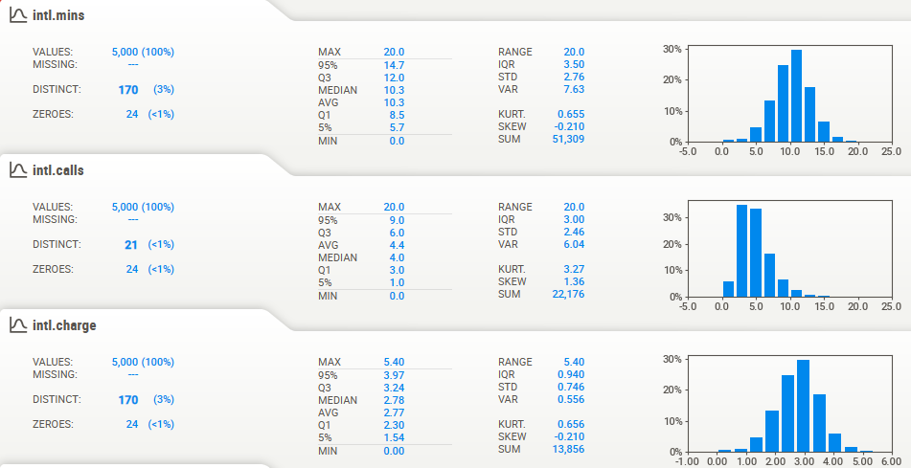
EDA…
Intl. min/calls/charges
one of the 3 features may be sufficient for the model;
intl_charge may be considered which has good correlation with the churn.

Slide 18
EDA…
day min/calls/charges
one of the 3 features may be sufficient for the model;
day_charge may be considered which has good correlation with the churn.

Slide 19
EDA…
evening min/calls/charges
one of the 3 features may be sufficient for the model;
eve_charge may be considered which has good correlation with the churn.

Slide 20
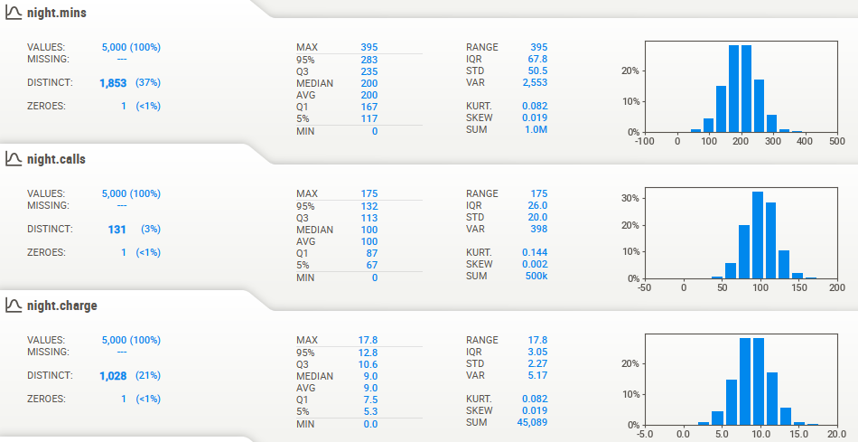
EDA…
night min/calls/charges
one of the 3 features may be sufficient for the model;
night_charge may be considered which has good correlation with the churn.

Slide 21
EDA…
Customer calls
increase in number of customer calls (> 3): higher portion of churn

Slide 22
EDA…
churn
Overall churned customers = 14.1 %;
Intl_plan, voice_plan, customer_calls may be significant categorical features for the churn prediction;
All ‘charge features’ may be significant numerical features for the churn prediction.

Slide 23
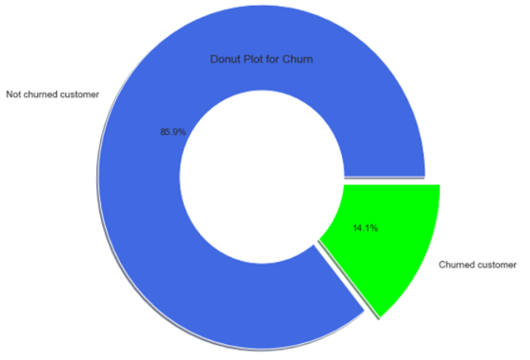
EDA…
Imbalance of the target variable
The given dataset is moderately imbalanced on the category of the target variable ‘churn’ (yes or no), which is a common challenge with the real world data;
Initially the dataset was considered as such for the model, metrics and validations;
Balancing was considered in later and the results were compared.

Slide 24
Selection of features
Variables | Insight/observation | Model component
Categorical State: Area code: Voice plan: Intl plan Churn Numerical Account length Voice messages Intl mins/calls/charge Day mins/calls/charge Eve. mins/calls/charge Night mins/calls/charge Customer calls | Wide range of churn: 5.08 – 26.92 %. Area-wise churn: 13.86%(415), 14.05%(408), 14.76%(510). churn: 16.45% (no voice plan), 7.71% (have voice plan). churn: 42.07% (have intl. plan), 11.22% (no intl. plan). Target variable. No clear significance observed. 10% correlation with churn observed. Redundant features. Intl charge only considered. Redundant features. Day charge only considered. Redundant features. Day charge only considered. Redundant features. Night charge only considered. Increase in customer calls increased % churn. | Yes No Yes Yes Yes No Yes Yes (Intl charge) Yes (Day charge) Yes (eve. charge) Yes (night charge) Yes
4 categorical, 6 numerical features were considered for the classification model.

Slide 25
Classification models - Screening
Logistic regression
KNN
Naïve Bayes
SVM
Decision Tree
Random Forest
Bagging
Ada Boost
XG Boost
399 outliers removed from ‘customer calls’.
They are customers who made > 4 calls
Original dataset
Outliers removed from ‘customer calls’
Balanced dataset: Random over sampling
* default hyperparameters

Slide 26
Classification models
Model | Original dataset Accuracy % |  | Outliers removed from ‘customer calls’ Accuracy % |  | Balanced dataset Accuracy %
 | Train | Test | Train | Test | Train | Test
Logistic Regression | 85.9 | 87.3 | 90.2 | 88.9 | 78.1 | 77.9
KNN | 91.5 | 86.7 | 93.2 | 87.8 | 95.5 | 90.4
Naïve Bayes | 85.8 | 86.3 | 89.5 | 87.8 | 64.1 | 65.6
SVM | 93.8 | 87.2 | 95.5 | 88.1 | 97.2 | 93.6
Decision Tree (entropy) | 95.8 | 94.1 | 97.5 | 93.3 | 94.1 | 91.7
Decision Tree (gini) | 95.6 | 93.7 | 97.8 | 93.7 | 94.3 | 91.2
Random Forest (RF) | 96.2 | 94.6 | 97.6 | 94.8 | 96.1 | 94.0
Bagging(base_est: RF) | 93.6 | 92.0 | 96.1 | 93.1 | 95.8 | 93.2
AdaBoost(base_est: RF) | 98.7 | 94.8 | 98.7 | 94.8 | 99.3 | 96.8
XG Boost Classifier | 98.9 | 95.0 | 98.9 | 95.0 | 99.9 | 98.0
Tuned hyperparameters, where applicable.
K-Fold cross validation, confusion matrix, classification report, classification accuracy/error/ precision/recall /TPR/FPR/specificity were calculated for all the above cases.

Slide 27
Results: XG Boost (y_test, y_pred_test)
Original dataset
Outliers removed from ‘customer calls’
Balanced dataset
TN
FP
FN
TP
Balanced dataset gave excellent model, however, FPR is slightly higher, specificity is slightly lower.

Slide 28
Results
ROC Curve, AUC, K-fold (No. of splits =5) cross validation
Original dataset
Outliers removed from ‘customer calls’
Balanced dataset
AUC: 84.05%
AUC: 80.07%
AUC: 97.66%
Cross validation:
Accuracy: 93.9 %
NMSE: 0.247
Cross validation:
Accuracy: 94.5 %
NMSE: 0.233
Cross validation:
Accuracy: 96.5 %
NMSE: 0.186

Slide 29
Classification model: Summary
XG Boost Classifier was found to be the best of all the models;
The model improved significantly after balancing (Random over-sampling) the dataset;
Removal of outliers from the feature “customer calls” did not improve the model as required.

Slide 30
Model deployment

Slide 31
Model deployment

Slide 32
Project Summary
Two object features were converted to numerical;
31 rows contained ‘Nan’ values, imputed with mean of the feature;
High correlation observed within some redundant features (i.e. intl-mins, intl_calls or intl_charges), which were removed while model building;
All the numerical variables contained outliers, which were not removed;
Data balancing was performed to improve the model performance;
Autoviz report gave interesting plots and information about the dataset.

Slide 33
Challenges
Presence of outliers in all the features of the dataset may have some impact on the prediction results;
Working with the imbalanced dataset;
Some errors were faced while deploying the model using streamlit;
Main challenge was with the ‘deployment of model’ due to lack of sufficient knowledge;
Some of the team members had training on ‘Heroku’ only, which is a paid version presently.

Slide 34
Thank you

